Slide 1
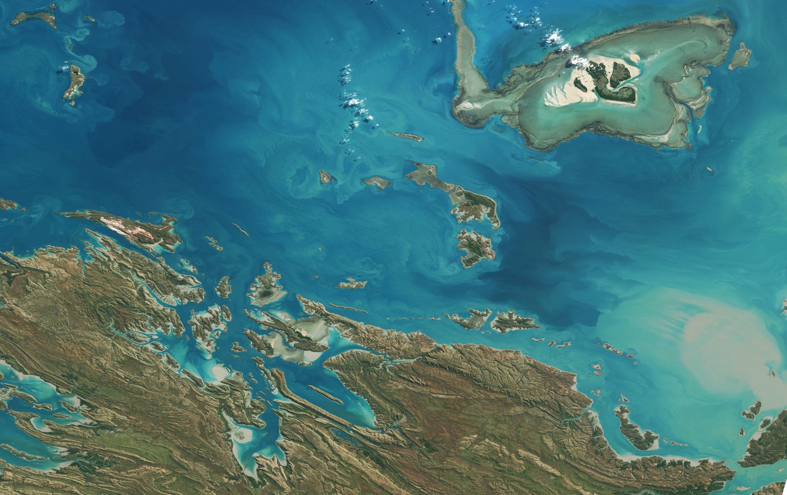
Australian Ocean Colour Activities
2016 Update
Oceans & Atmosphere
IOCCG-21, Santa Monica, 1-3 March 2016

Slide 2
Overview
National Coordination and Landscape
  Copernicus Data Hub
  Australian Geoscience Data Cube
Validation activities
  IMOS: Lucinda Jetty, Bio-optical database, Moorings and Gliders
  Biogeochemical Argo
  Southern Ocean Bio-Optics
  Marine Productivity Data Buoy
  International Indian Ocean Expedition 2 opportunities
Information services and decision support
  E-reefs
  WAMSI
Modelling ocean colour

Slide 3
National coordination and landscape

Slide 4
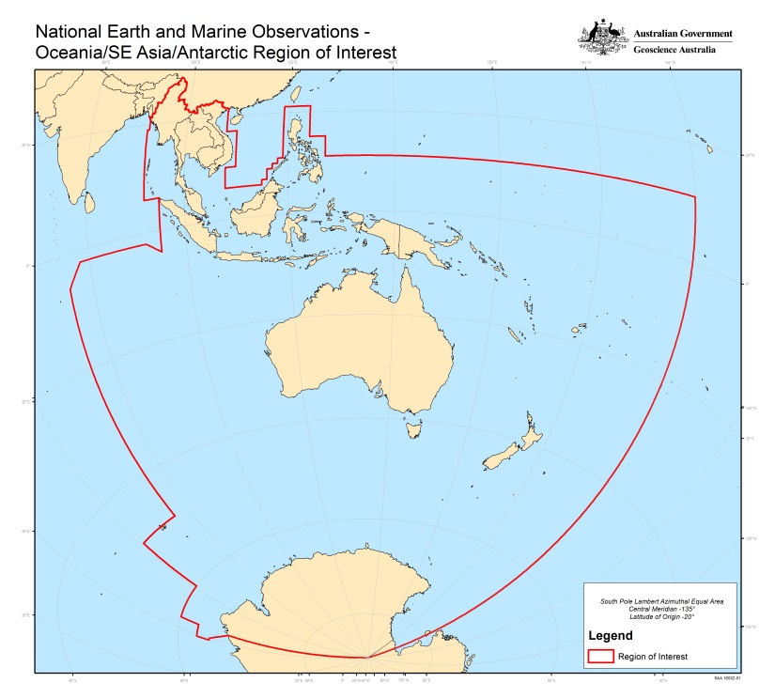














Australia’s Regional Copernicus Data Access/Analysis Hub
An integrated ‘Team Australia’ approach to
Support government information requirements.
Support the broader objective of enhancing access to satellite Earth observation data by research, industry and civil society.
Facilitate collaboration between Australians, Europeans and inhabitants of the South-East Asia-South Pacific region in exploitation of Earth observation data.
Benefits for: Australia, the region, EC/ESA/EUMETSAT, and the global satellite EO community.
All Sentinel Products For
Supporting
Consortium
Partners
Collaborators

Slide 5
Australia’s Regional Copernicus Data Access/Analysis Hub
ESA
IntHub
EUMETCAST
Terrestrial
GEANT/AARNET
Partnerships
(pay-per-use)
Master Repository (NCI)
Delivery for:
Australia
Region
Regional
Portal
(a la ‘SciHub’)
Original Format Data Files
(HSM Storage)
Agreed Standards
Analysis-Ready Data
(Lustre/spinning disk)
Interoperable
Services
(e.g. Thredds)
R&D for:
Research/Academia
Civil Society
Government
Industry
Australia and Region
Cloud and HPC
(Petascale)
Industry Exploitation
Operational Products
Deep National Archives
(Government Systems)

Slide 6

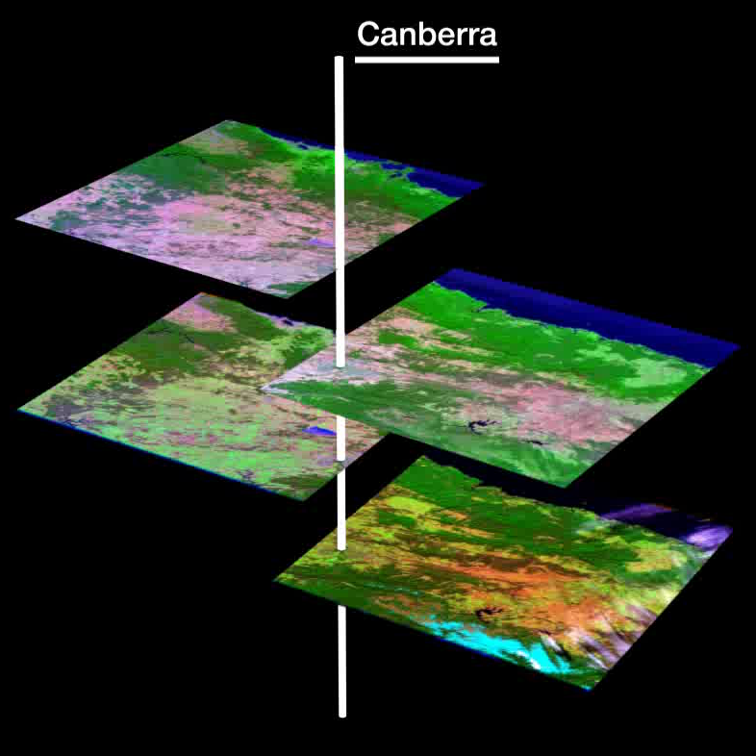
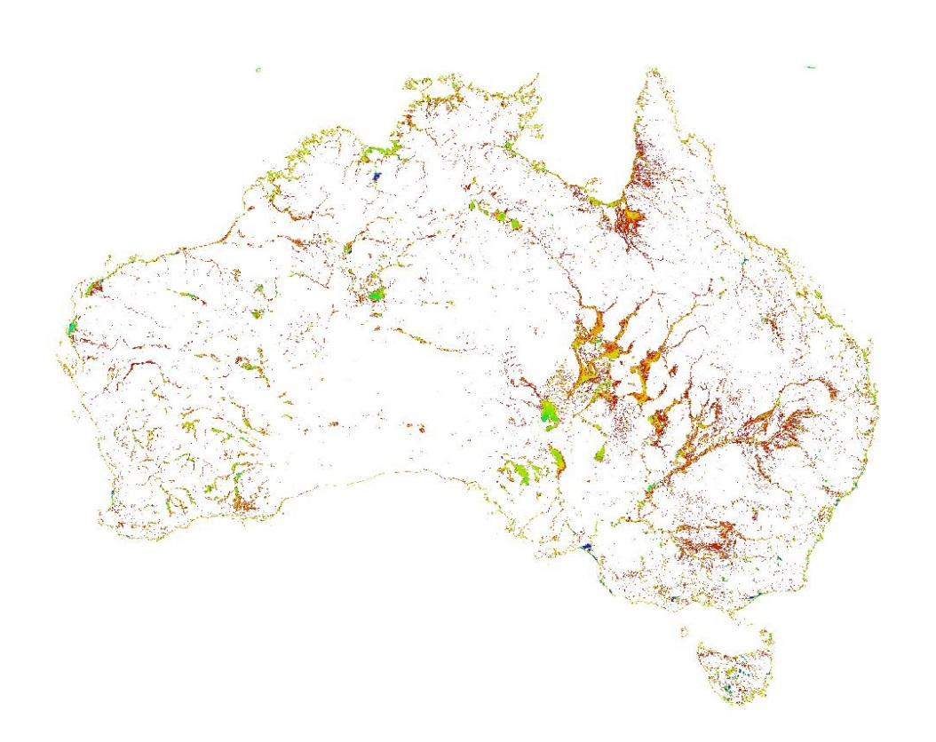




Australian Geoscience Data Cube
Continental surface water detection example
15 Years of data from LS5 & LS7 (1998-2012), 25m Nominal Pixel Resolution
Approx. 133,000 individual scenes in ~12,400 passes
Entire archive of 1,312,087 tiles => 21x1012 pixels visited*
‘Cubing’ Landsat images
*3 hrs at NCI (elapsed time) to compute

Slide 7
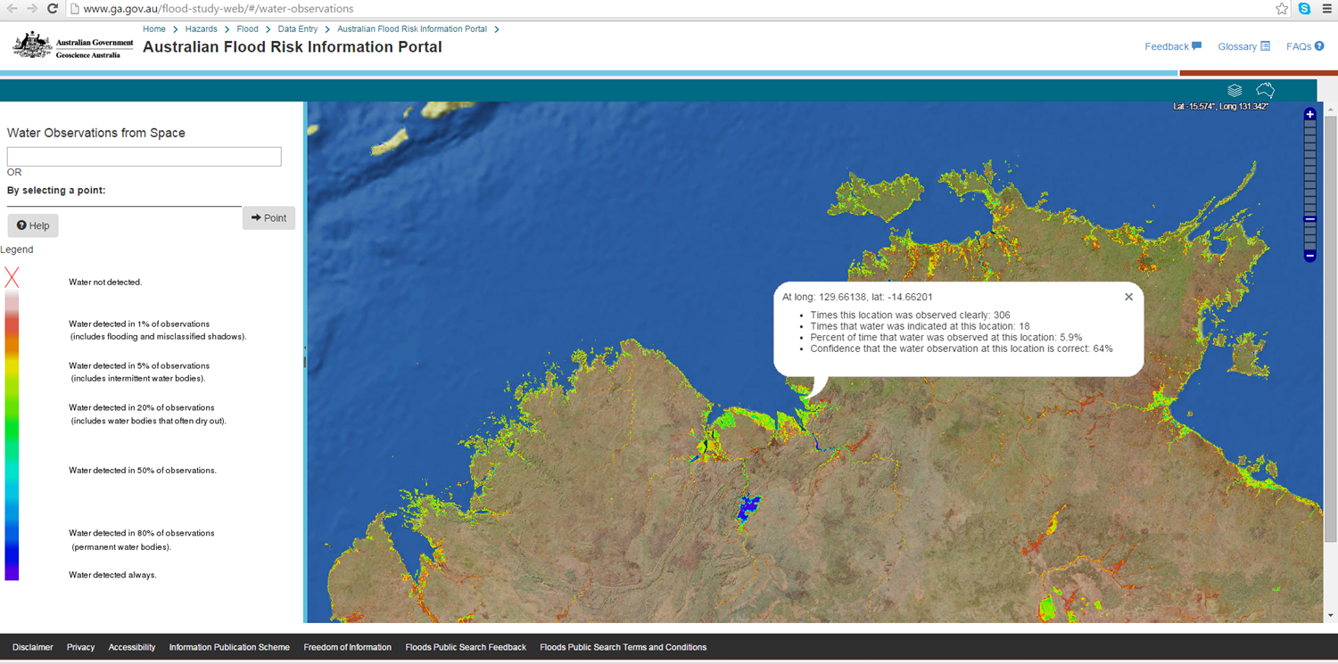
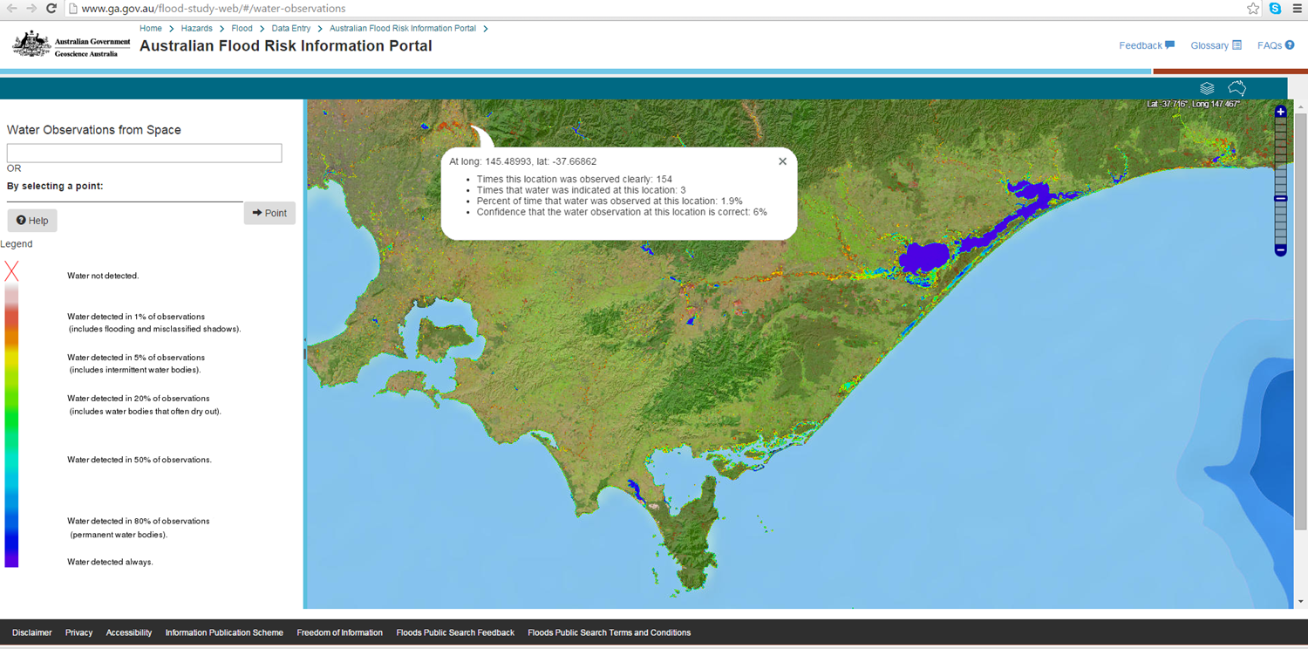

Slide 8
Validation

Slide 9




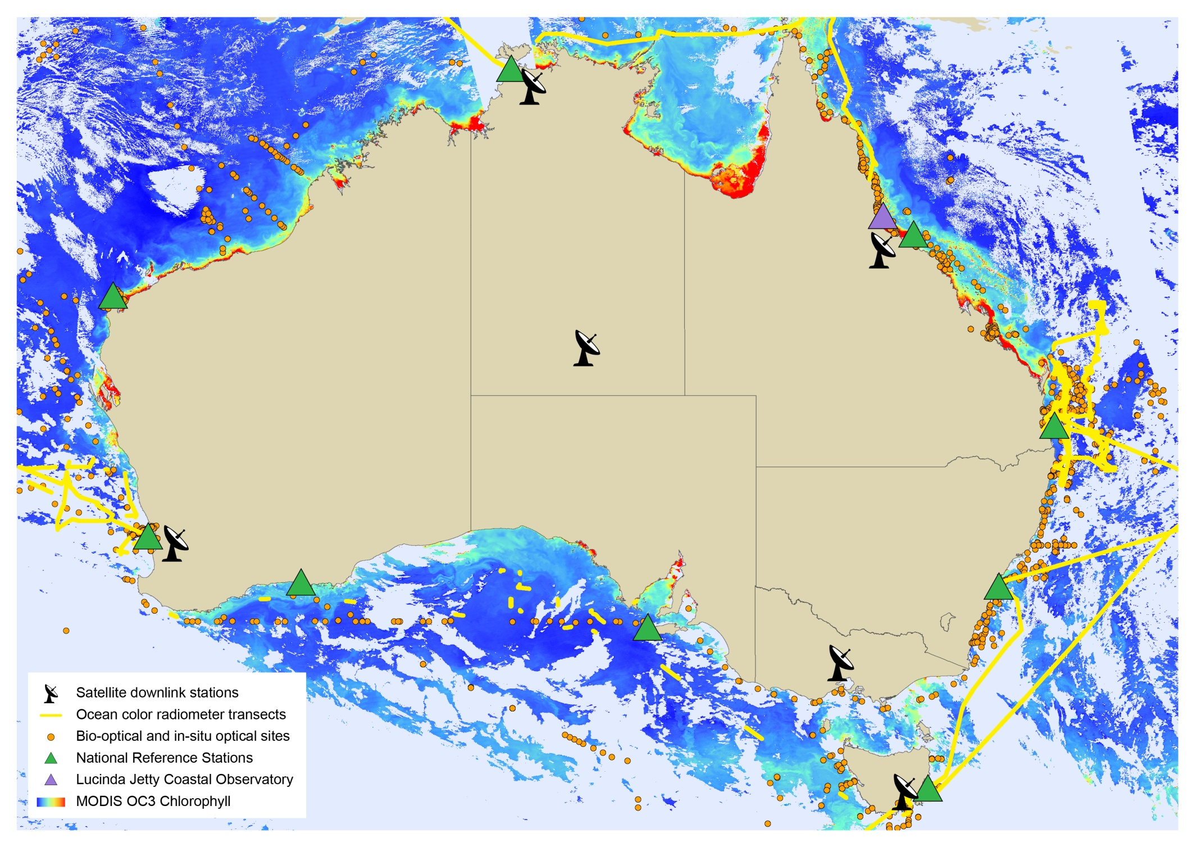
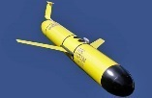
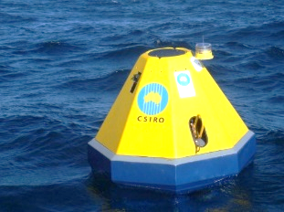
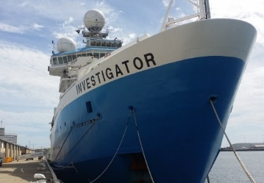
IMOS for Validation
AERONET-OC, NOMAD, S3-VT, MERMAID, GCOM-C IOPs

Slide 10
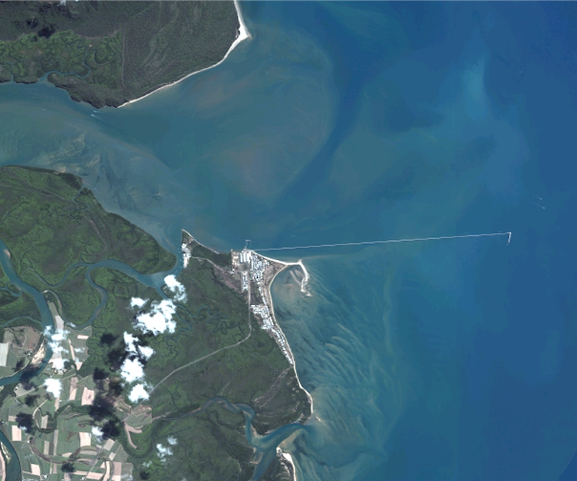
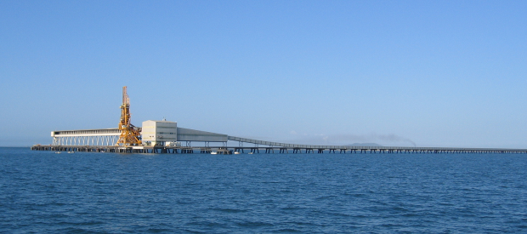
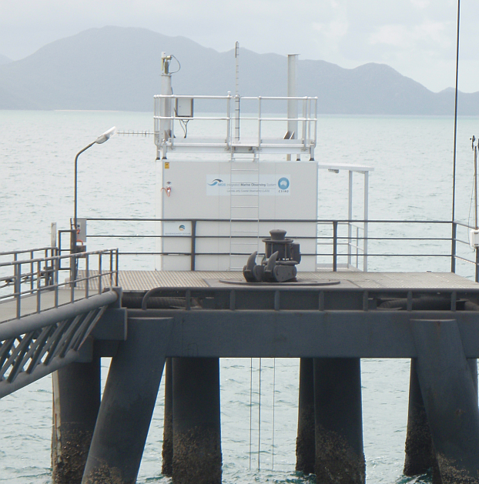

Lucinda Jetty Coastal Observatory for Case 2 OC validation
~6km long jetty in GBR (avoids coastal adjacency)
AERONET-OC site
Above and in water radiometry, IOPs and constituents
Highly Case-2 waters
Timeseries from 2009
Thomas.Schroeder@csiro.au
Notes:
At LJCO two complementary data streams are acquired above water radiometry and in water measurement of the optical properties.
An autonomous above-water radiometer performs radiometric measurements for determining water-leaving radiance and atmospheric measurements for retrieving aerosol optical properties as part of NASA's AERONET-OC network.
An in situ underwater instrument package is deployed to characterize the inherent optical properties of these complex coastal waters.

Slide 11
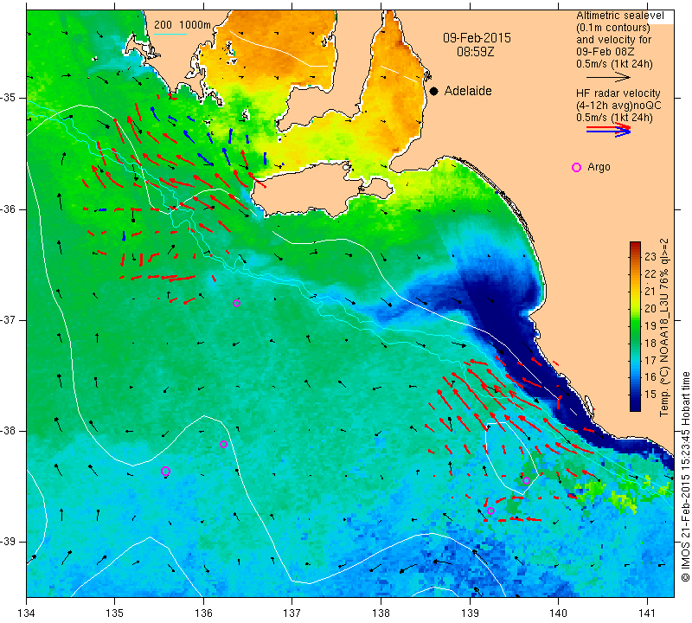
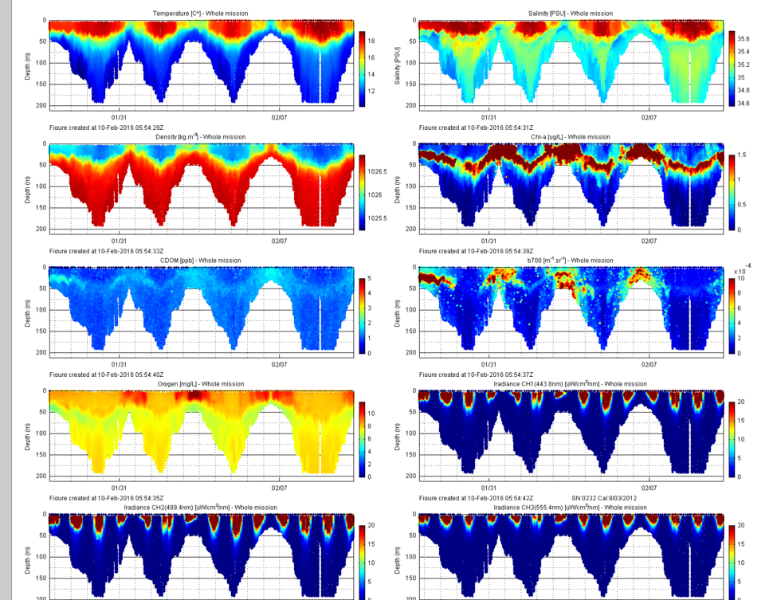
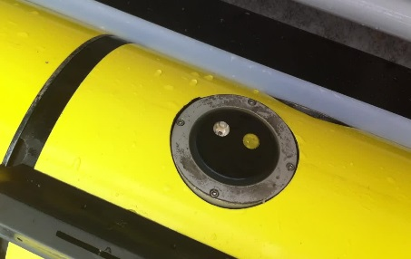
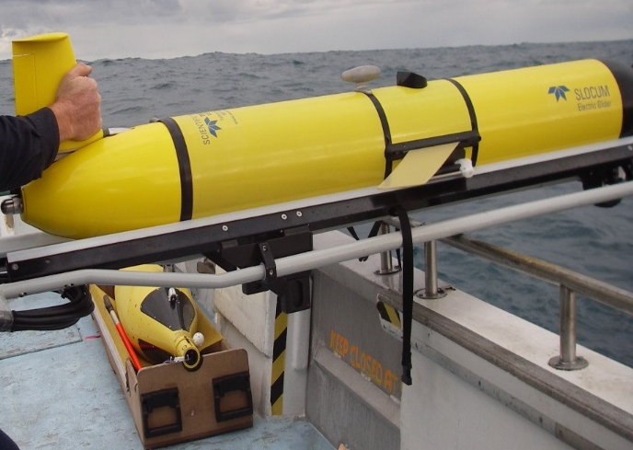
IMOS Slocum glider capturing bio-optics and oceanography of Bonny Upwelling in South Australia
  Ecopuck instrument
  Fluorescence
  (Ex/Em 470/695 nm)
  Backscatter (700 nm)
  CDOM Ex/Em 370/460 nm
Temperature
Salinity
Density
Fluorescence
CDOM
Backscatter b700
SST of Sth Australia showing Bonny upwelling
Slocum glider
Oxygen
Irradiance 443.8 nm
Irradiance 489.4 nm
Irradiance 555.4 nm
Coincidence of high FLU and backscatter possible coccolithophore bloom?
Paul.Thomson@uwa.edu.au

Slide 12
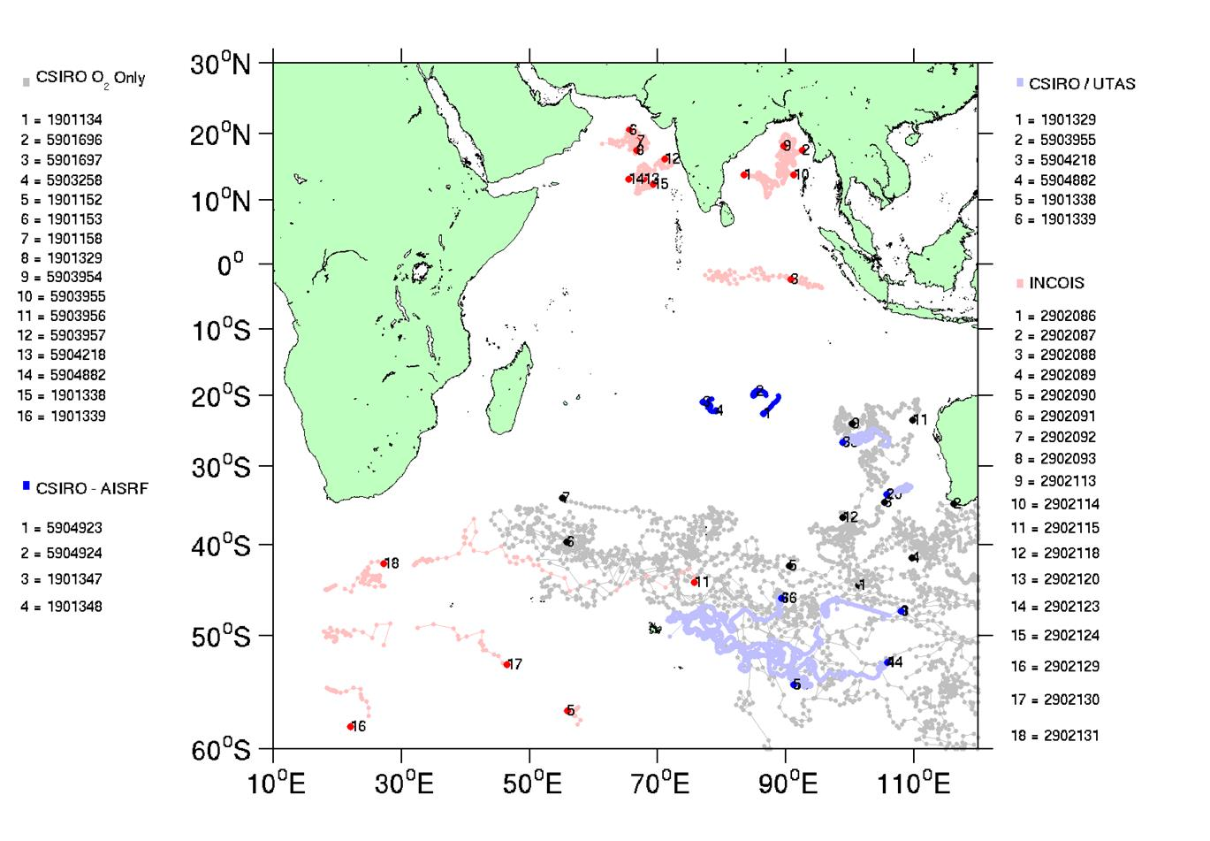
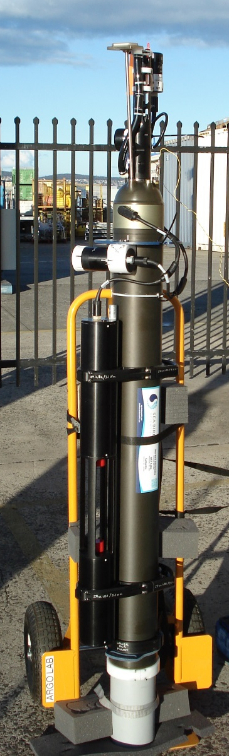
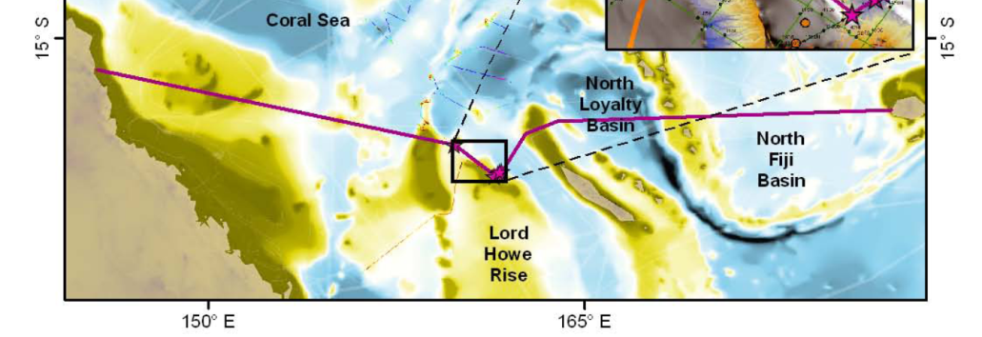
Biogeochemical-Argo for validation
Joint project with India
Deployments for SOCOM in Southern Ocean
Gap is South Pacific Ocean:
plan for bio-optical voyage and float deployment June 2016
Opportunity to collaborate
Nick.Hardman-Mountford@csiro.au
Notes:
Update IO Map
Update Cruise Map – add SO, Nansen and Pacific
Future BGC Argo – Emmanuel talk

Slide 13
Satellite match-ups Community composition
Δtime_{MODIS} = -4.82h
Δ time_{VIIRS} = -2.20h
Nick.Hardman-Mountford@csiro.au

Slide 14
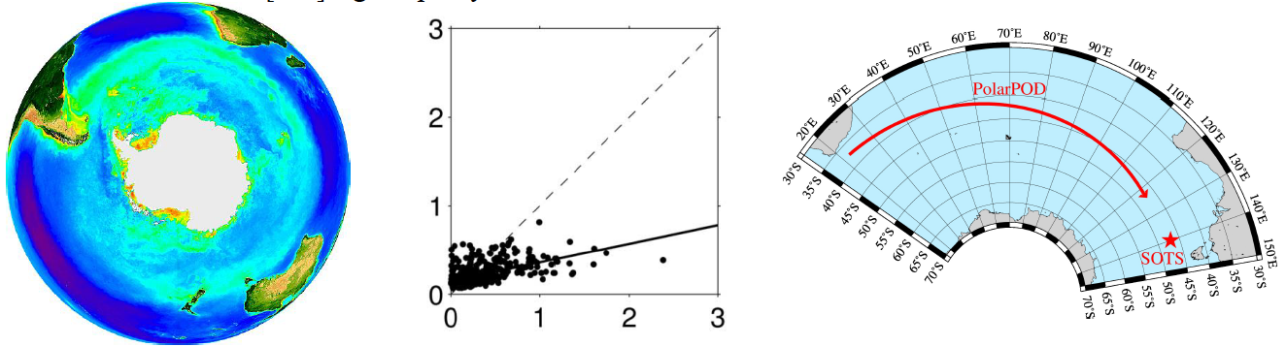
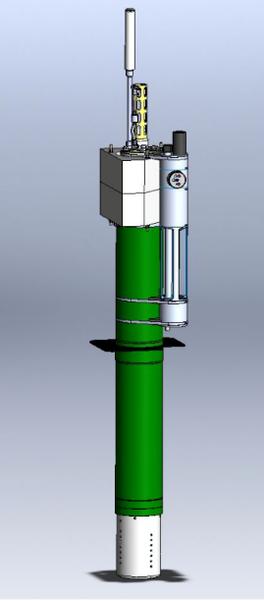
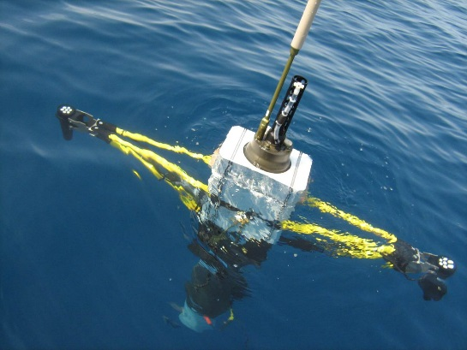
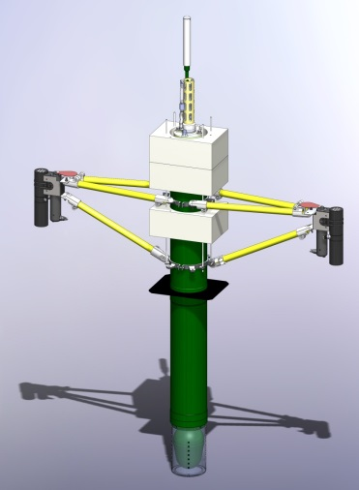
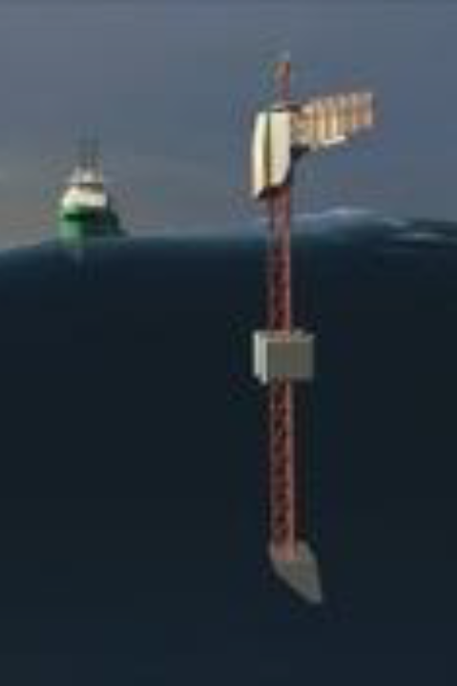
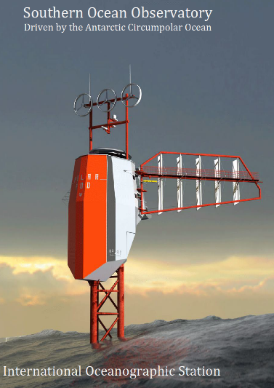
Bio-optics & ocean colour remote sensing in the southern ocean
David.Antoine@curtin.edu.au
From Johnson et al., JGR, 2013
© NASA/GSFC
Partners: UTAS, CSIRO, CNRS (France), NASA & U Maine (USA), U Sherbrooke (Canada)
(ARC DP16 “Discovery” proposal)
Combination of autonomous platforms to collect optical and radiometry data in support to ocean colour remote sensing validation and algorithm development

Slide 15
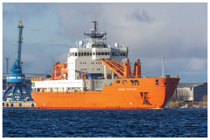
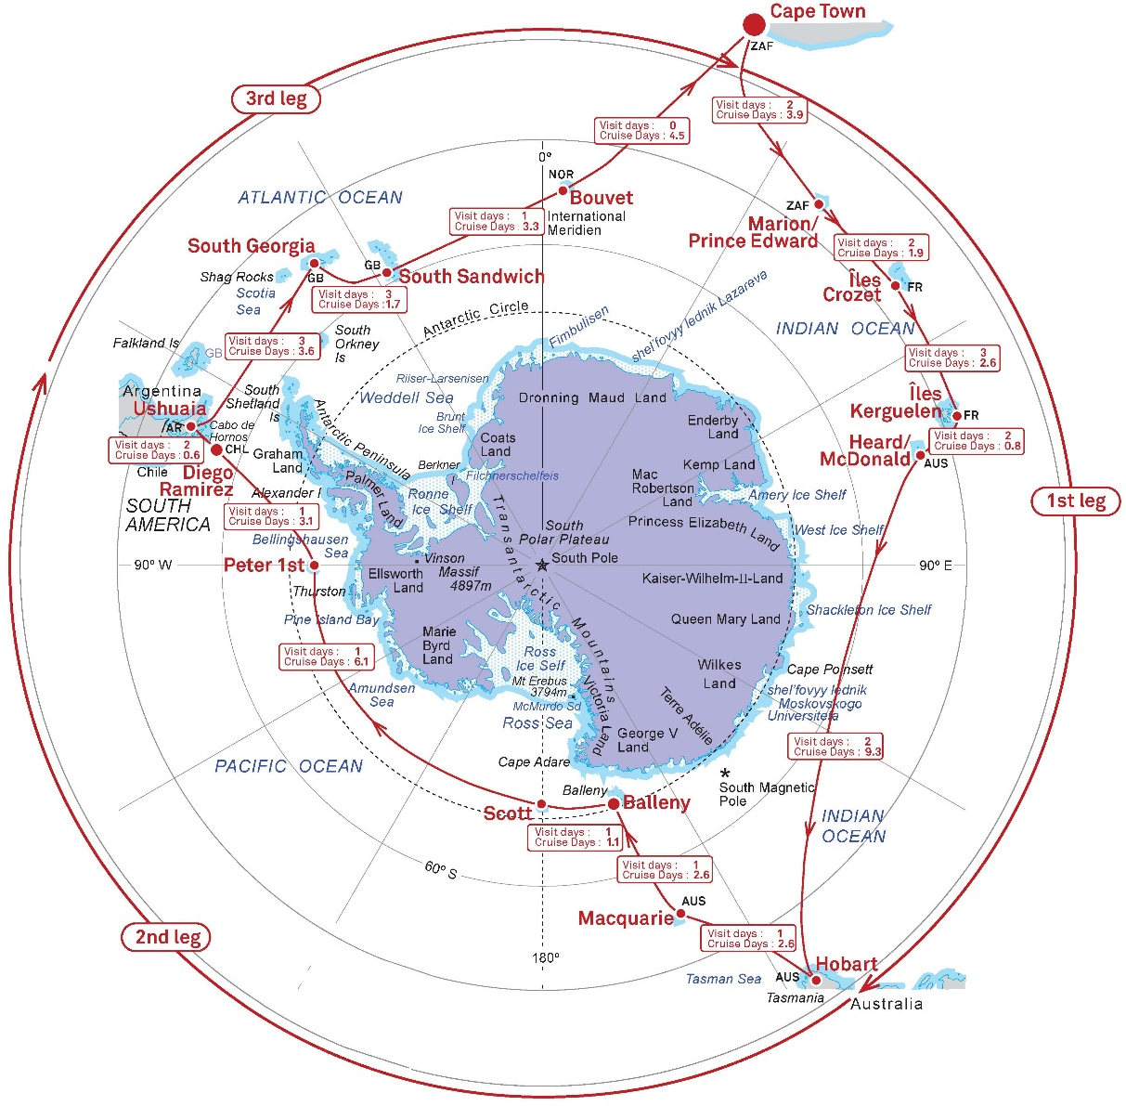
Bio-optics & ocean colour remote sensing in the southern ocean
David.Antoine@curtin.edu.au
The “Antarctic Circumpolar Expedition” (ACE) Dec 2016 – Feb 2017
Partners:
UTas
CSIRO
NASA
CNRS (France)
CSIR (South Africa)
Uni Sherbrooke (Canada)
Uni Maine (USA)
Bigelow Lab (USA)

Slide 16
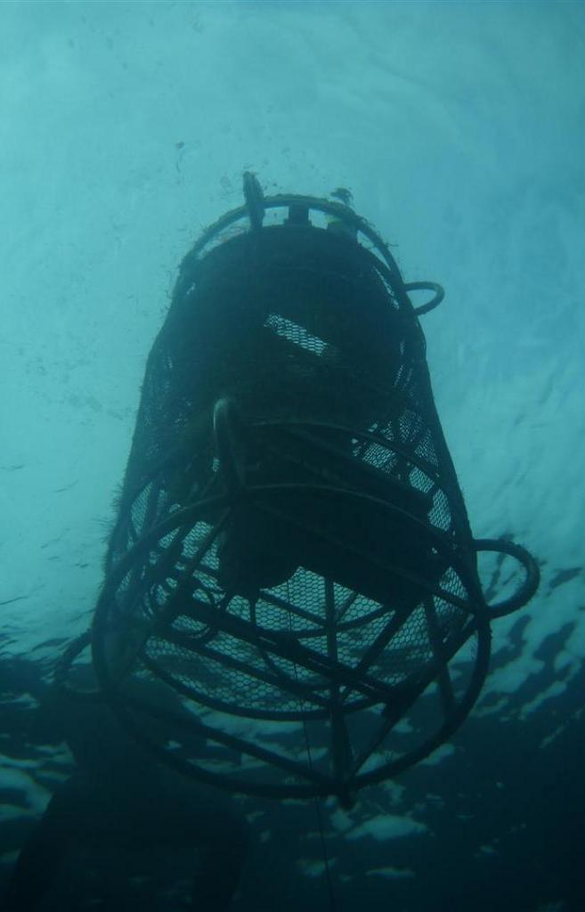
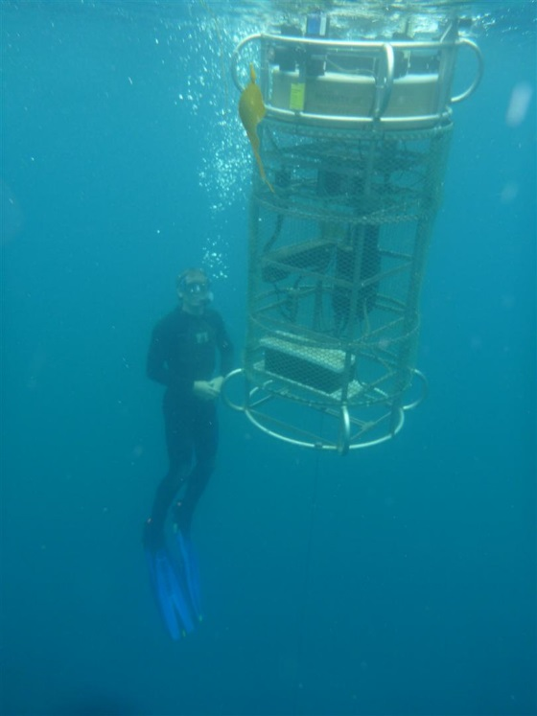
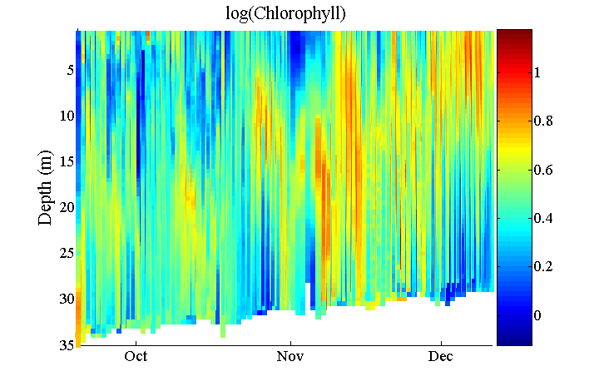
Indian Ocean bio-optical profiling mooring off Perth
David.Antoine@curtin.edu.au
Related to validation and analysis of “ocean colour” satellite remote sensing observations, and to deriving water quality & primary productivity from satellite observations
ARC LIEF 16, Partners: UTSydney, CSIRO, WA Water Corporation, WA Dept of Fisheries

Slide 17
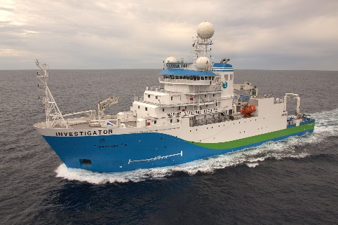
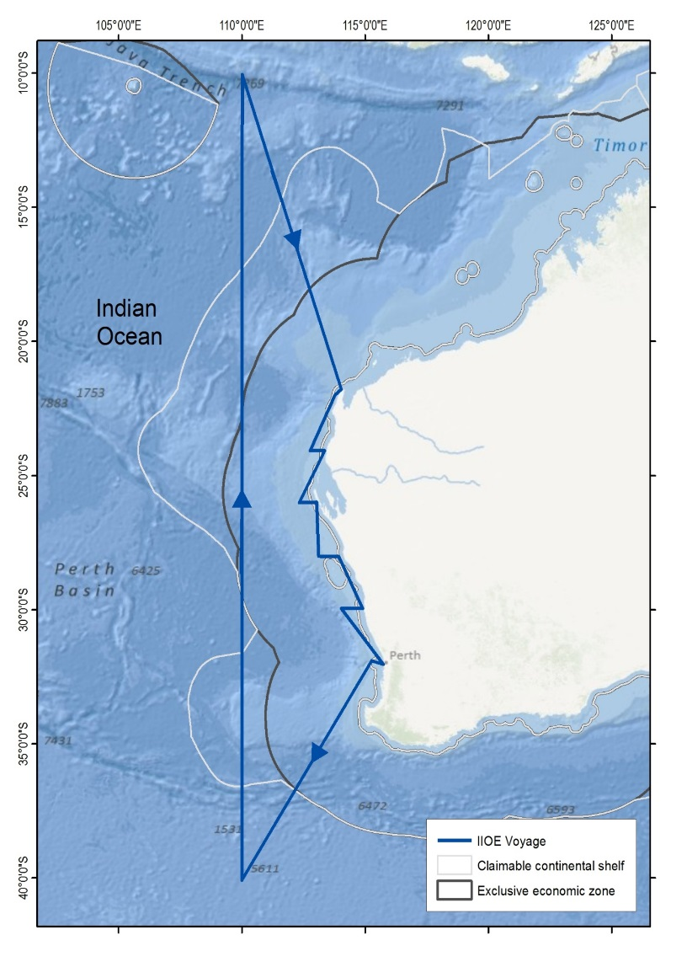
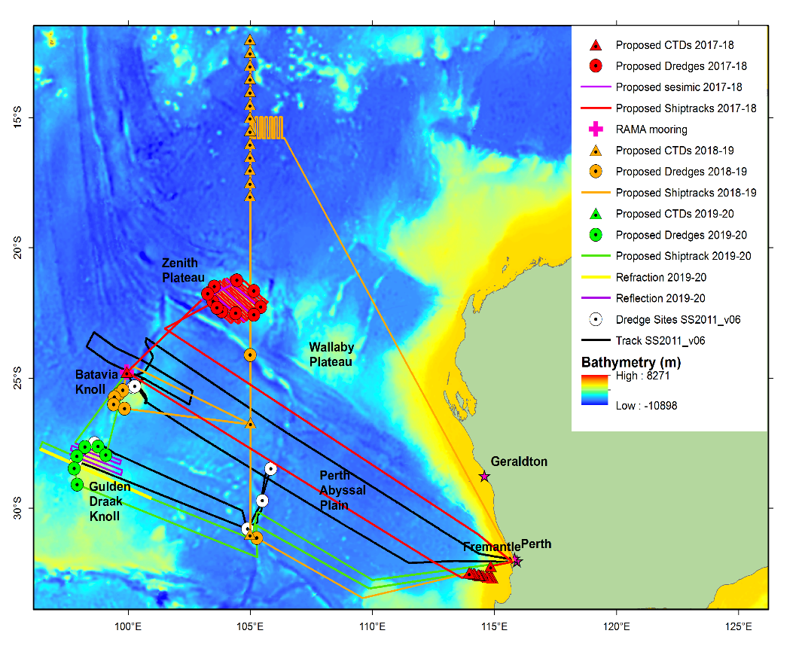
Research voyages on R/V Investigator in the frame of the “IIOE-2”
(International Indian Ocean Expedition 2)
(proposals submitted 4th September 2015)
David.Antoine@curtin.edu.au
2018; led by Murdoch Uni
2019, led by UTas
Curtin Uni Leading the bio-optics, satellite ocean colour and primary production sub-group (~ 10 people) UTS, UTas, CSIRO, SARDI, CNRS

Slide 18
Information services and decision support research

Slide 19
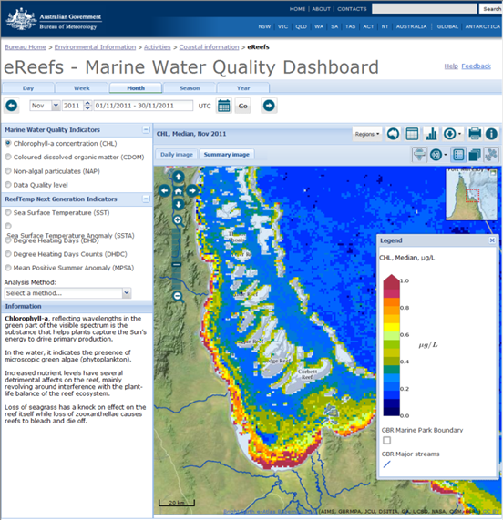
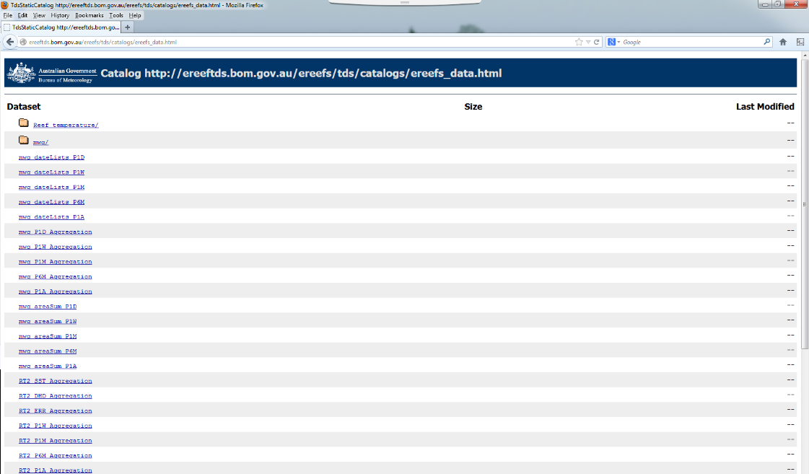
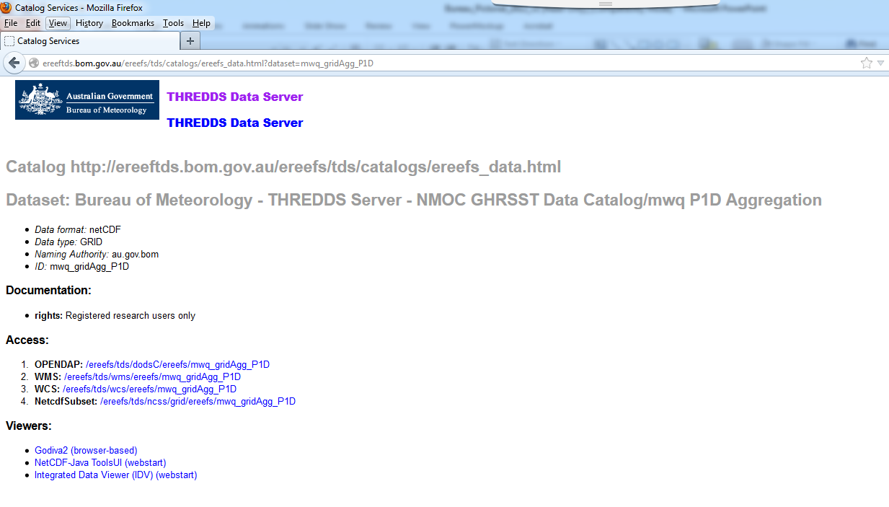
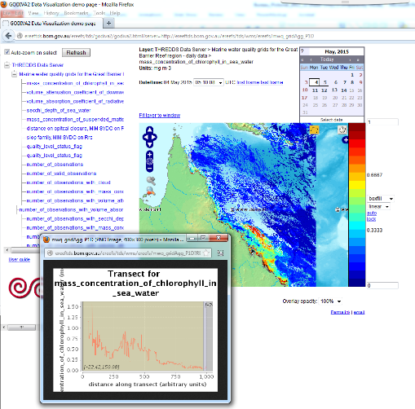
E-Reefs: Marine Water Quality Dashboard
http://www.bom.gov.au/marinewaterquality/
Dashboard
Data service
http://ereefs.org.au/
Thomas.Schroeder@csiro.au

Slide 20
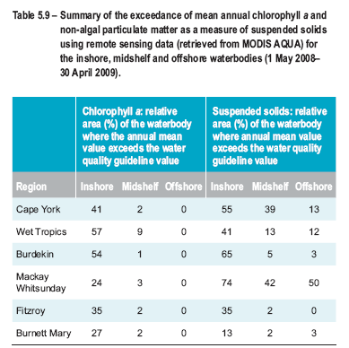
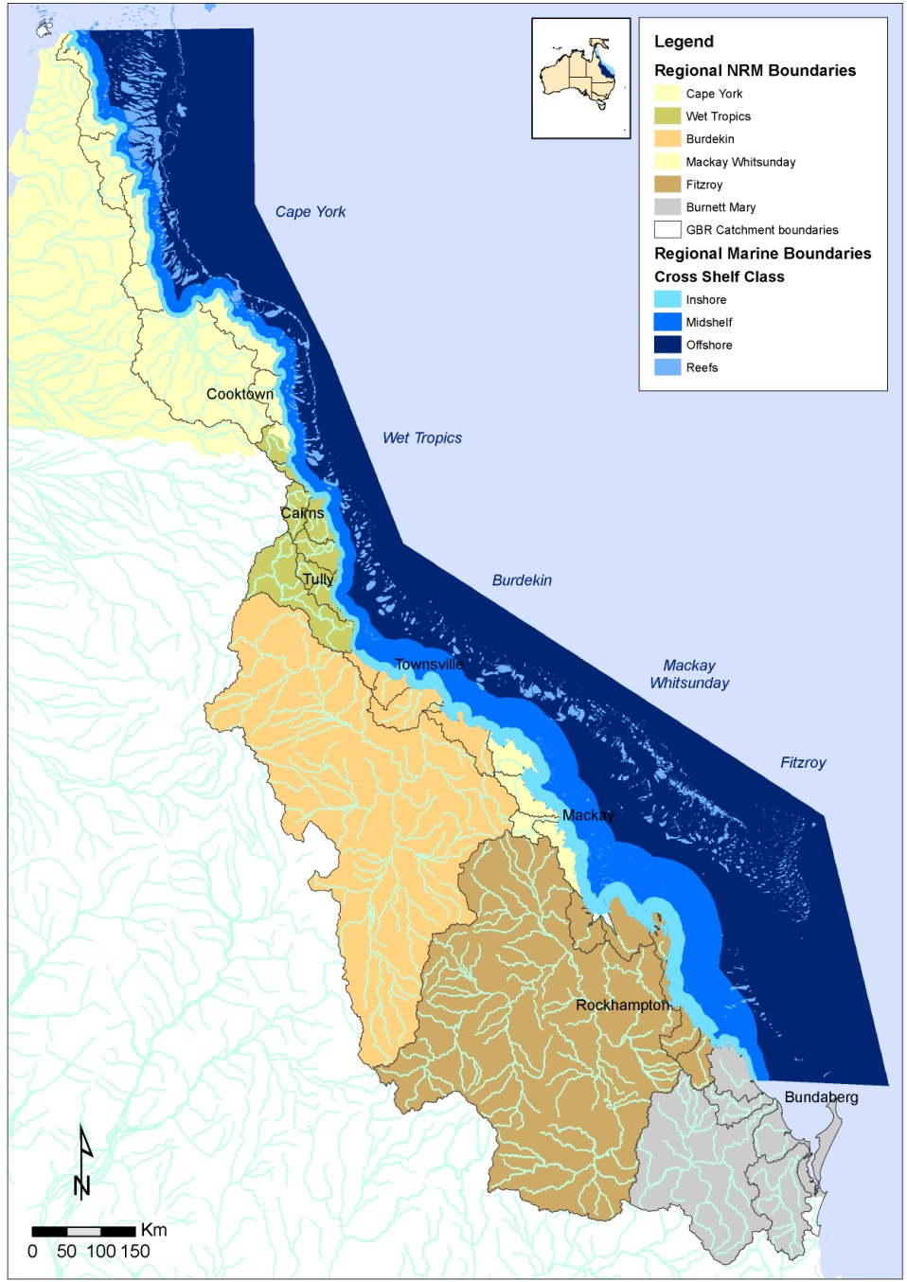
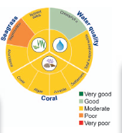
Assessing compliance with Water Quality Guidelines

Slide 21
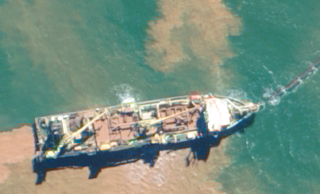

Remote sensing on the NW Shelf
(Pilbara and Kimberley)
David.Antoine@curtin.edu.au
WAMSI Dredge Node
  Routine monitoring of dredge
  plumes from space
  Impact of turbid plumes on the marine light environment
WAMSI Kimberley Marine Research Program
  Monitoring water turbidity on a regional scale
  Spatial and temporal patterns and changes in turbidity/light
  Impact of turbidity on the marine ecosystem
Notes:
Add CSIRO and WAMSI logos

Slide 22
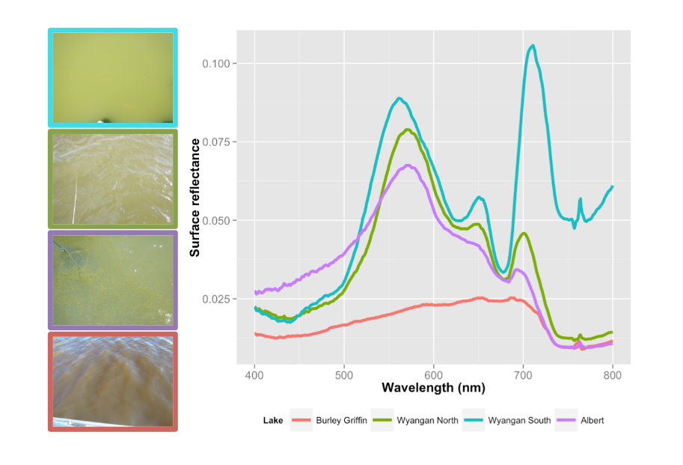
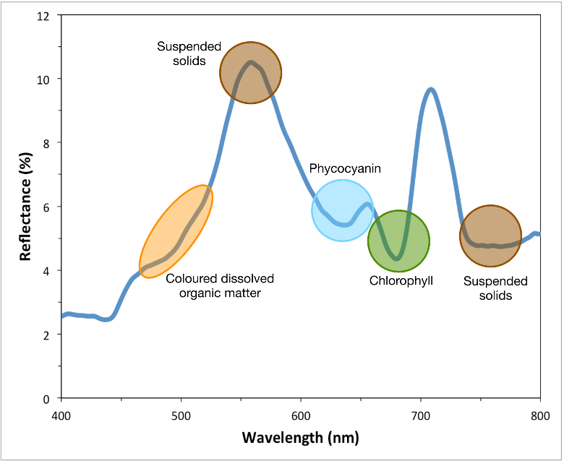
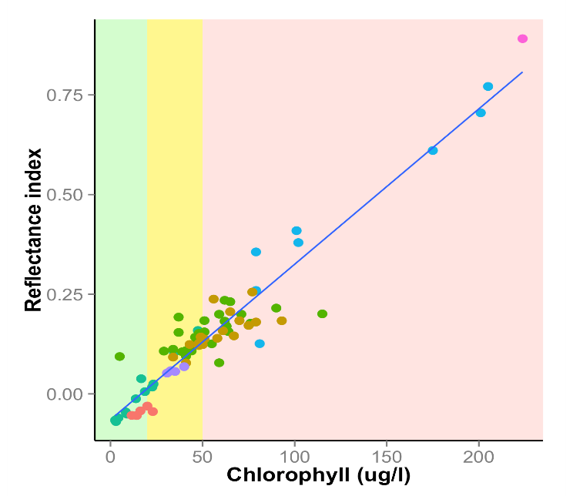
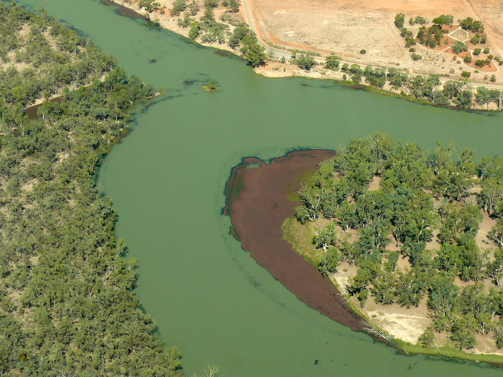
Algal Alert for Complex inland waters
R² = 0.91
Alert level | Chlorophyll level
Green | <20 ug Chl l⁻¹
Amber | >20-50 ug Chl l⁻¹
Red | >50 ug Chl l⁻¹
Tim.Malthus@csiro.au
Notes:
Fundamentally physically based approach…
Gives the ethos of the approach.

Slide 23
Modelling

Slide 24
Reflectance from BGC modelling
Baird et al. 2016. Environmental Modelling and Software 78: 79-96
Mark.Baird@csiro.au

Slide 25
Thank you

